Slide 1

A graph model for fault tolerant computing system
Graph theory

Slide 2
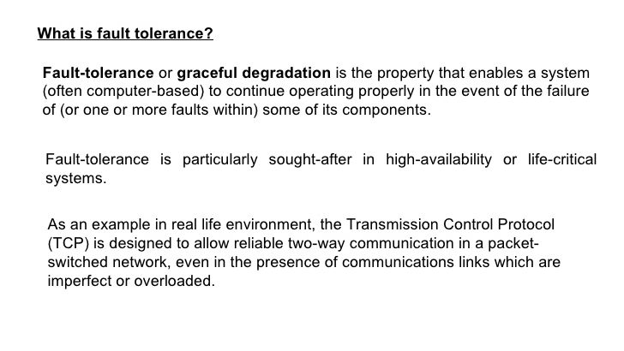

Slide 3
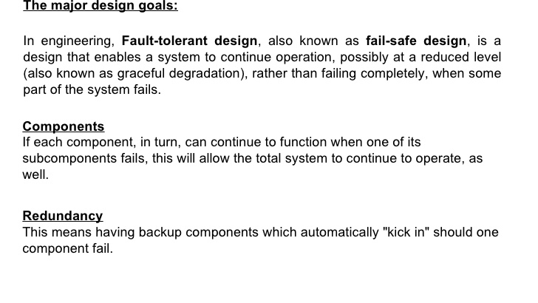

Slide 4
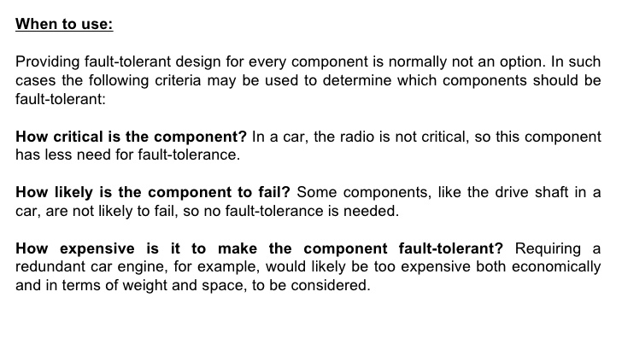

Slide 5
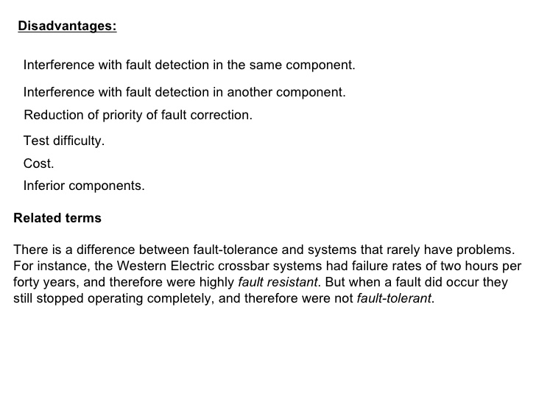

Slide 6
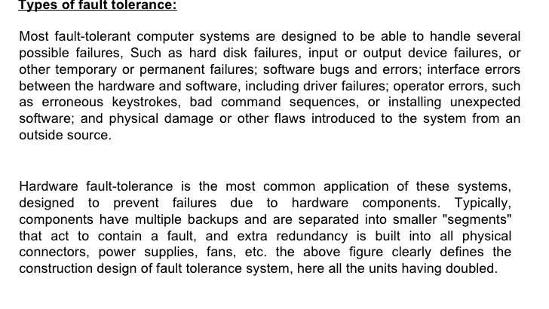

Slide 7
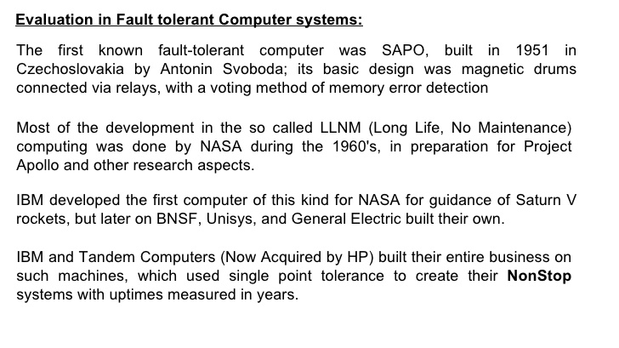

Slide 8
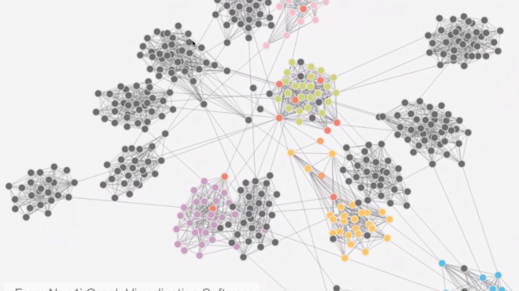
A graph model for fault tolerant computing systems:

Slide 9
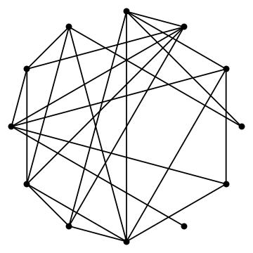
Here, the computer is represented as S and the algorithm to be executed by S is known as A. Both S and A are represented by means of graphs whose nodes represent computing facilities. It is shown that the algorithm A is executable by S if A is isomorphic to a sub graph of S. Facility types are indicated by numbers in parentheses.

Slide 10
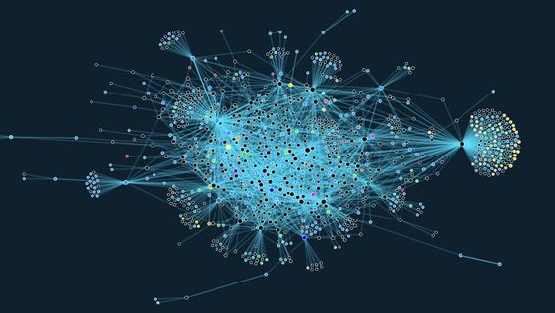
the graph indicates the types of facilities accessed by other facilities.For ex. The node x1 access the nodes x2 and x4. Similarly, the node x5 with facility type t1 access the facility types t3, t1 and t2 of nodes x6, x2 and x4 respectively.

Slide 11
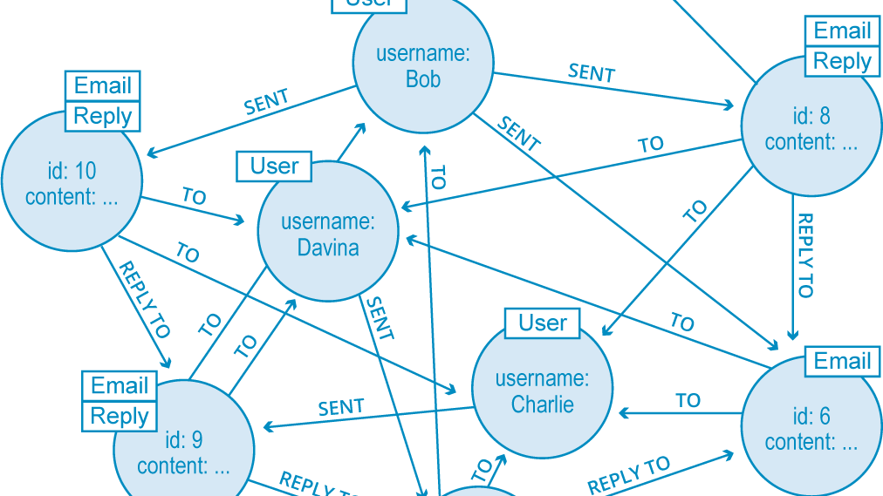
Graphical representation of algorithm:

Slide 12
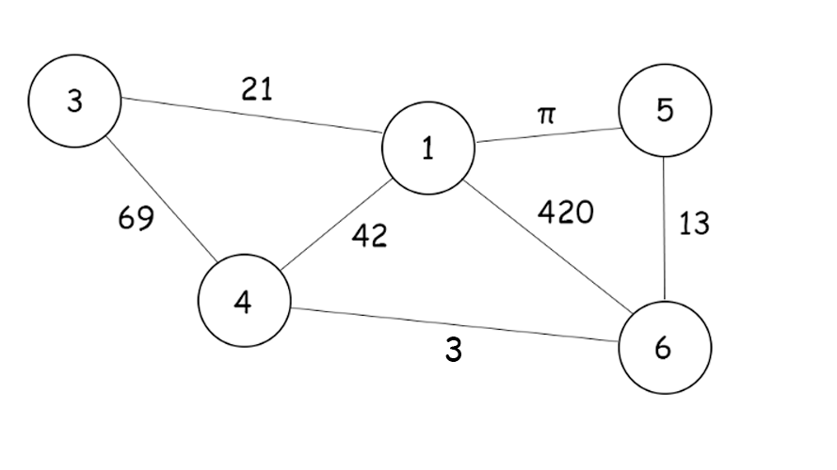
An algorithm will be defined in the form of a facility graph whose nodes represent the facilities required to execute the algorithm and whose edges represent the links required among these facilities.1-1 mapping of nodes of A into nodes of S.

Slide 13
A k-fault F in a system S is the removal of any k nodes {x1, x2, x3, x4…...x5} from S. All edges connected to these nodes are also removed. The resultant graph will be denoted by SF. It can be written F = {{x1, x2, x3, x4…...x5} . A system S is fault tolerant with respect to algorithm A and fault F, if A is executable by SF . 2. S is fault tolerant with respect to a set of algorithms {A1,A2,, A3,……Ap} and a set of faults {F1, F2,….Fq}, if Ai is executable by SFj for all i and j where 1 ≤ i ≤ p. If S is k-fault tolerance with respect to A, then S is j-FT(Fault Tolerance) with respect to A, for all j where 0 ≤ j ≤ k. G1 is fault tolerance with respect to G2.. It is not 2 FT because if the fault F = {x2, x4} is present, then G2 cannot be executed by G1 F

Slide 14
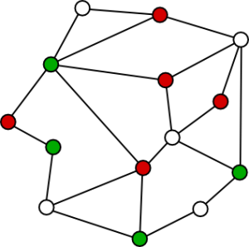
We have used Hamiltonian circuits and Hamiltonian path concepts to design optimal k-FT systems. The central idea focused here is to stress the importance of the graph model called facility graph to represent computing systems and the algorithms they execute. This model gives a precise definition of the basic concept of a k-fault tolerant system

Slide 15


